Slide 1
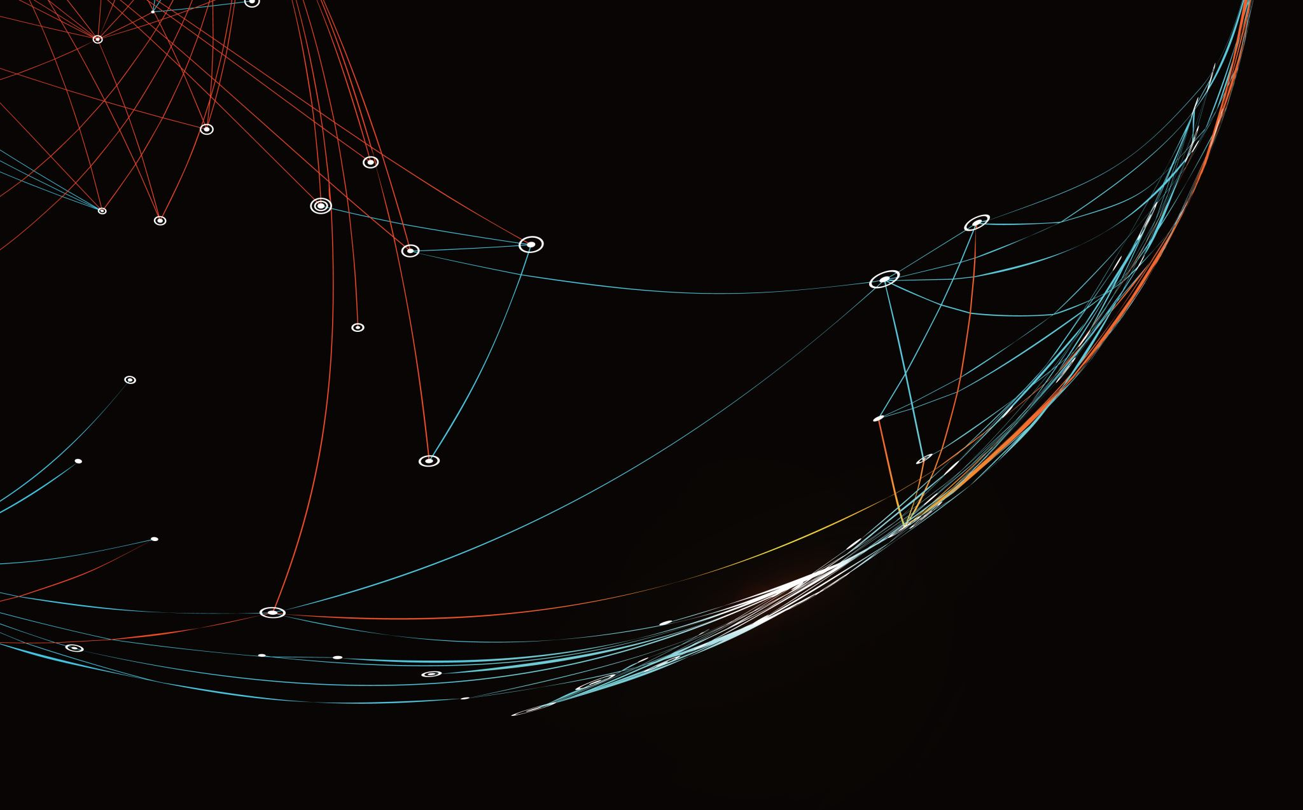
Security Assessment and Risk Management
Week 4 – Frameworks

Slide 2
Privacy Impact Assessment
An analysis of how personally identifiable information is collected, used, shared, and maintained.
The purpose of a PIA is to demonstrate that program managers and system owners have consciously incorporated privacy protections throughout the development life cycle of a system or program.
PIAs allow us to communicate more clearly with the public about how we handle information, including how we address privacy concerns and safeguard information.
PIAs are reviewed on an annual basis to ensure that they are accurate and up-to-date.

Slide 3
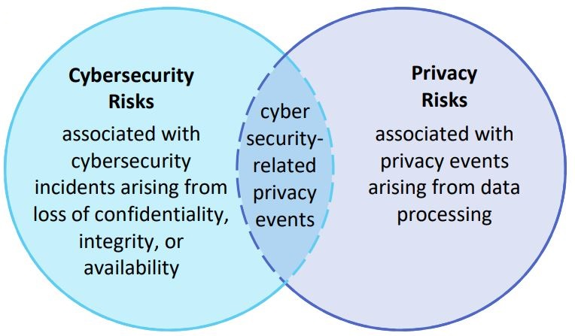

Slide 4
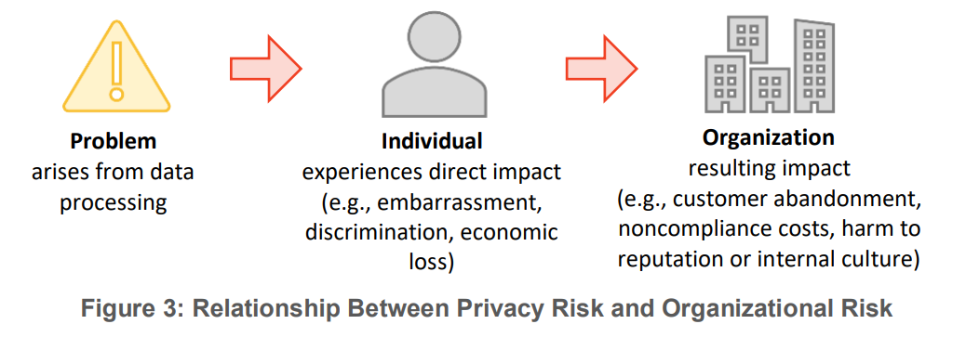

Slide 5
FAIR Privacy Factor Analysis in Information Risk (Privacy Version)
The probable frequency and probable magnitude of future privacy violations.
Privacy Risk
The probable severity of the privacy violation for the affected population and the consequential risks to that population
The probable frequency, given a time frame, that a threat actor acts towards an individual in a way that is a potential privacy violation.
Action Frequency
The probability that a threat actor’s acts will succeed.
Violation Magnitude
The probable frequency and probable magnitude of adverse consequences on the affected population
The probable frequency, given a time frame, that a
threat actor
acts towards
an individual
Attempt Frequency
Vulnerability
Severity
Secondary Consequences Risk
The probable severity of the privacy violation across the at-risk population. Note severity is subjective and comparative to other similar violations
Threat Opportunity
Probability of Action
Capability
Difficulty
Consequences Frequency
Consequences Magnitude
The probable frequency, given a time frame, at which a threat actor will come in contact with an individual or the individual’s information.
The probability that a threat actor will act in a way that is a potential privacy violation, if given the opportunity.
The skills and resources available to a threat actor, in a given situation, to act in a way that is a potential violation.
The impediments that a threat actor, in a given situation, must overcome to act in a way that is a potential violation.
The probable frequency
of adverse consequence on the affected population.
The probable magnitude of adverse consequence on the affected population.

Slide 6
Privacy Violations Based on Dan Solove’s Taxonomy of Privacy
Non-Information
Information
Collection Surveillance Interrogation
Invasion Intrusion Decisional Interference
Information Processing Aggregation Insecurity Identification Secondary Use Exclusion
Information Dissemination Breach of Confidentiality Disclosure Exposure Increased Accessibility Blackmail Appropriation

Slide 7
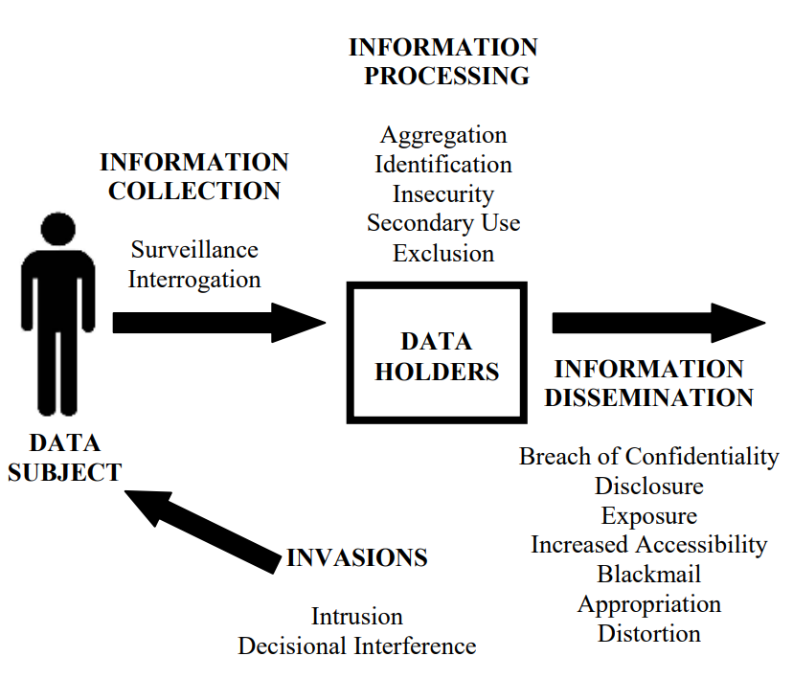

Slide 8
8 OECD Privacy Principles
• Collection Limitation Principle
• Data Quality Principle
• Purpose Specification Principle
• Use Limitation Principle
• Security Safeguards Principle
• Openness Principle
• Individual Participation Principle
• Accountability Principle

Slide 9
Adverse Consequences
Subjective
Objective
Psychological
Embarrassment
Anxiety
Suicide
Behavioral
Changed Behavior
Reclusion
Lost Opportunity
Employment
Insurance & Benefits
Housing
Education
Economic Loss
Inconvenience
Financial Cost
Social Detriment
Loss of Trust
Ostracism
Loss of Liberty
Bodily Injury
Restriction of Movement
Incarceration
Death

Slide 10
EXAMPLE
What are the privacy risks associated with the 2020 US Decennial Census?
In particular, the risk of the US Government’s (threat actor) secondary use (privacy violation) of ethnicity information resulting in the loss of liberty (adverse consequence) to people in the US (affected population)?

Slide 11
EXAMPLE: Annualized Risk of 2020 US Decennial Census
Annualized Risk | Severity | Loss of Liberty (years)
10th Percentile | 133,000 | 12,000
Median | 245,000 | 22,000
90th Percentily | 400,000 | 35,000
Factors calculated using historical data on incarceration of Japanese-Americans in World War 2 based on Census Data. Composite factors (like Attempt Frequency) based on Monte Carlo simulation.
OPPORTUNITY
A person’s information will be pulled into the Census once a decade to once a century, with once a decade most likely.
PROBABILITY OF ACTION
There have been 22 decennial censuses and in one (1940) the US Government used data to profile and incarcerate people based on ethnicity.
CAPABILITY
The US Government has immense skills and resources at its disposal.
Privacy Risk
Action Frequency
Violation Magnitude
CONSEQUENCES FREQUENCY
Of the entire US Population in 1940’s, 0.8% of the population was incarcerated
CONSEQUENCES MAGNITUDE
Those that were incarcerated were placed in internment camps for between 2.2 and 2.9 years, with the median being 2.5 years.
Attempt Frequency
Vulnerability
Severity
(relativistic num)
Secondary Consequences Risk
10% to 30%
20% most likely
Threat Opportunity
Probability of Action
Capability
Difficulty
Consequences Frequency
Consequences Magnitude
0.01 – 0.1/yr 0.1 most likely
1 – 10 % 4.5% most likely
90 - 99% 99% most likely
Loss of Liberty 0.0 – 1.0% 0.8% most likely
Loss of Liberty (years)
2.2 – 2.9 2.5 most likely

Slide 12
Note on Organizational Risk The US government eventually disbursed more than $1.6 billion (equivalent to $3,240,000,000 in 2016) in reparations to 82,219 Japanese Americans who had been interned and their heirs (about $7500/year incarcerated based on 2016 dollars)
We could translate this into an annual risk of $64m - $281m (median $154m) to the US Government for the 2020 Census. However, doing so could be seen as trivializing and dehumanizing the toll on the population. FAIR Privacy analysis is fundamentally about quantifying risks to people, not organizations, with an aim at reducing privacy violations (See Hoepman privacy design strategies on next slide)
What is the risk of the US Government’s (threat actor) secondary use (privacy violation) of ethnicity information resulting in the loss of liberty (adverse consequence) to people in the US (affected population)?
Based on historical data, internment of Japanese-Americans during World War 2, the annualized risk is between ½ and 2 million secondary uses of ethnicity information with a median of 1.2 million resulting in between 8,500 and 37,500 years of incarceration, with a median of 20,500 years.
An analyst could substitute statistics about more modern ethnic populations at-risk in the US, rather than relying on strictly historical data about Japanese-Americans.

Slide 13
Mapping Hoepman Privacy Design Strategies to FAIR Privacy Factors
Privacy Risk
Action Frequency
Violation Magnitude
Attempt Frequency
Vulnerability
Population Magnitude
Adverse Consequences Risk
Inform & Control
Opportunity
Probability of Action
Capability
Difficulty
Consequences Frequency
Consequences Magnitude
Minimize &
Separate
Enforce & Demonstrate
Hide & Abstract

Slide 14
NIST Privacy Framework
Functions organize foundational privacy activities at their highest level. They aid an organization in expressing its management of privacy risk by understanding and managing data processing, enabling risk management decisions, determining how to interact with individuals, and improving by learning from previous activities.
Categories are the subdivisions of a Function into groups of privacy outcomes closely tied to programmatic needs and particular activities.
Subcategories further divide a Category into specific outcomes of technical and/or management activities. They provide a set of results that, while not exhaustive, help support achievement of the outcomes in each Category
Notes:
They are not intended to form a serial path or lead to a static desired end state. Rather, the Functions should be performed concurrently and continuously to form or enhance an operational culture that addresses the dynamic nature of privacy risk.

Slide 15
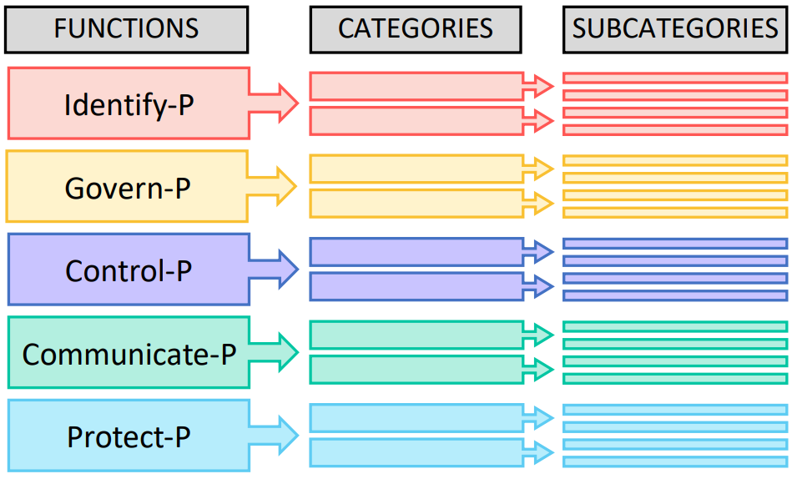

Slide 16
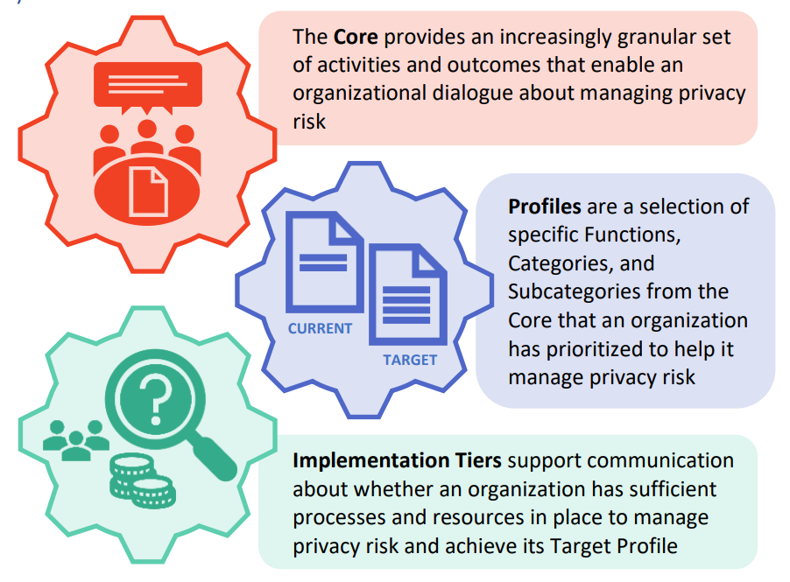

Slide 17
Privacy Framework Functions – Identify-P
Develop the organizational understanding to manage privacy risk for individuals
arising from data processing.
The activities in the Identify-P Function are foundational for effective use of the Privacy Framework. Inventorying the circumstances under which data are processed, understanding the privacy interests of individuals directly or indirectly served or affected by an organization, and conducting risk assessments enable an organization to understand the business environment in which it is operating and identify and prioritize privacy risks.

Slide 18
Privacy Framework Functions – Govern-P
• Govern-P – Develop and implement the organizational governance structure to enable an ongoing understanding of the organization’s risk management priorities that are informed by privacy risk.
The Govern-P Function is similarly foundational, but focuses on organizational-level activities such as establishing organizational privacy values and policies, identifying legal/regulatory requirements, and understanding organizational risk tolerance that enable an organization to focus and prioritize its efforts, consistent with its risk management strategy and business needs.

Slide 19
Privacy Framework Functions – Control-P
• Control-P – Develop and implement appropriate activities to enable organizations or individuals to manage data with sufficient granularity to manage privacy risks.
The Control-P Function considers data processing management from the standpoint of both organizations and individuals.

Slide 20
Privacy Framework Functions – Communicate-P
• Communicate-P – Develop and implement appropriate activities to enable organizations and individuals to have a reliable understanding and engage in a dialogue about how data are processed and associated privacy risks.
The Communicate-P Function recognizes that both organizations and individuals may need to know how data are processed in order to manage privacy risk effectively.

Slide 21
Privacy Framework Functions – Protect-P
• Protect-P – Develop and implement appropriate data processing safeguards.
The Protect-P Function covers data protection to prevent cybersecurity-related privacy events, the overlap between privacy and cybersecurity risk management.

Slide 22
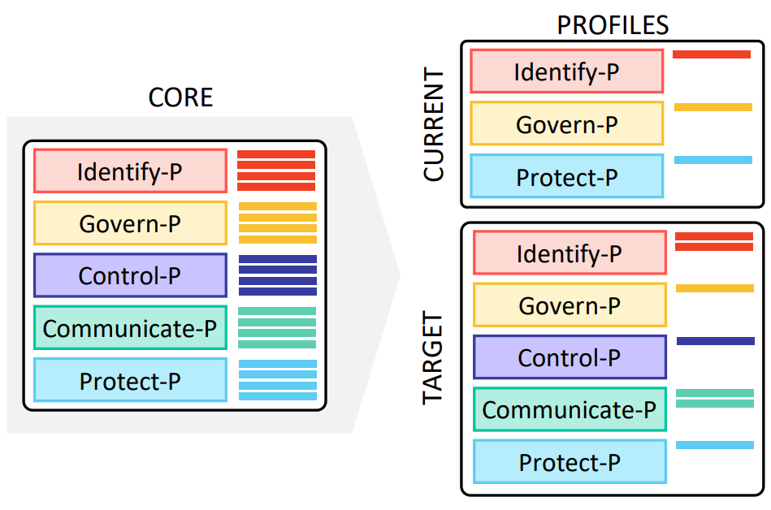

Slide 23
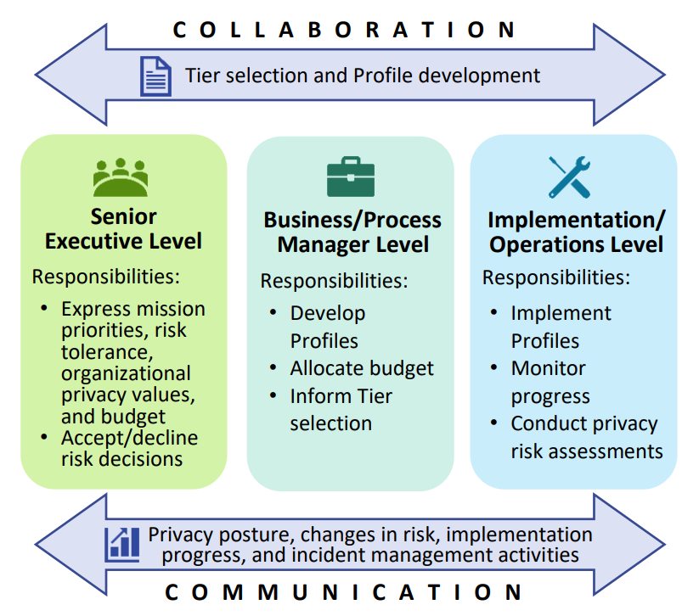

Slide 24
OCTAVE-S
Operationally Critical Threat, Asset, and Vulnerability EvaluationSM (OCTAVE®) approach defines a risk-based strategic assessment and planning technique for security.
OCTAVE is a self-directed approach, meaning that people from an organization assume responsibility for setting the organization’s security strategy.
OCTAVE-S is a variation of the approach tailored to the limited means and unique constraints typically found in small organizations (less than 100 people).

